Slide 1

ME 322: Machine Design
Rolling Contact Bearings II
Prof. S. K. Kakoty

Slide 2
Selection of Taper Roller Bearings
The terminology related to taper roller bearings is slightly different from that of ball or cylindrical roller bearings.
In taper roller bearing, the inner race is called a cone, and the outer race, the cup.
The cup is separable from the remaining assembly of the bearing, consisting of the cone, cage and rollers.
These two parts can be separately mounted to the housing and the journal.
In this type of bearing, it is possible to make adjustment for radial clearance.
There are two varieties of taper roller bearings involving single-row and double-row constructions.

Slide 3
Here, the discussion is restricted to single-row taper roller bearings.
In tapper roller bearings, the line of action of the resultant reaction makes an angle with the axis of the bearing.
This reaction can be resolved into radial and axial components.
Therefore, taper roller bearings are suitable for carrying combined axial and radial loads.
The conical surface of each roller is subjected to pressure, which acts normal to the surface.
Therefore, even if the external force acting on the bearing is purely radial, it induces a thrust reaction within the bearing.
To avoid separation of the cup from the cone, this thrust reaction must be balanced by an equal and opposite force.

Slide 4
One of the methods of creating this force is to use atleast two tapper roller bearings on the same shaft.
In such a case, the thrust reactions of two bearings balance each other.
There are two types of popular construction, with two bearings on the same shaft.
When two bearings are mounted on the shaft, with their backs facing each other, the mounting is said to be back-to-back or indirect mounting.
The construction, which involves two bearings with their fronts facing each other, is called face-to-face or direct mounting.
These constructions are illustrated in fig. 1 and fig. 2.
The thrust component F_{a} created due to radial load F_{r} is approximately given by
………………………….. (1)
where Y is the thrust factor

Slide 5
In the preliminary stages of bearing selection, the value of Y is taken as 1.5.
The equivalent dynamic load for single row taper roller bearing is given by
……………………. (2)
…………………….. (3)
The dimensions, dynamic load carrying capacity, values of factor Y, value of e and designation of single-row taper roller bearing are given in Table 1 below.
The equations for calculating thrust load for various bearing arrangements and load cases are given in Figs 1 and 2.
The equations given in the figures are based on the following assumptions:
The bearings are adjusted against each other to give zero clearance in operation but are without pre-load
Bearings A and B are exactly identical ( )
P= F_{r} when (F_{a}/F_{r}) ≤ e
P = 0.4F_{r} + YF_{a} when (F_{a} /F_{r})> e
Y_{A} =Y_{B} =Y

Slide 6
In the bearing arrangements shown in figures, the bearing A is subjected to the radial load F_{rA} while bearing B to radial load F_{rB}.
K_{a} is the external axial force acting on the shaft.
The radial loads F_{rA} and F_{rB} are always considered positive, even in cases when both act in the direction opposite to that shown in figures.

Slide 7
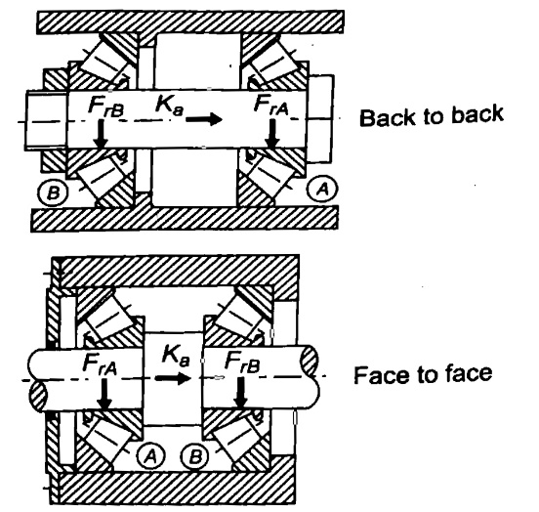
Arrangements | Load Case | Axial Loads
Fig. 1: Axial Load of Tapper Roller Bearing

Slide 8
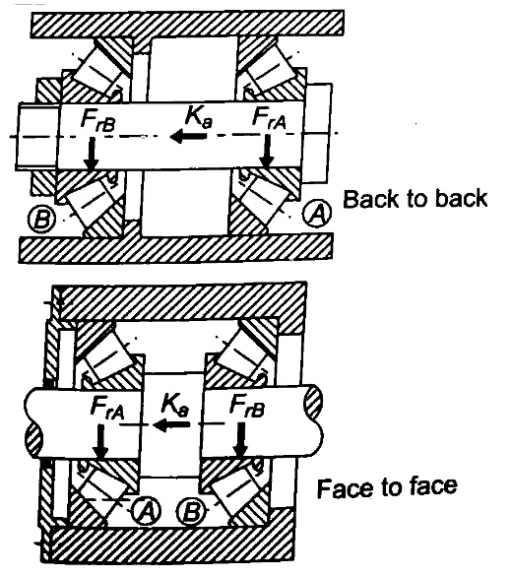
Arrangements | Load Case | Axial Loads
Fig. 2: Axial Load of Tapper Roller Bearing

Slide 9
Table 1: Dimensions (mm), dynamic capacities (N) and Calculation factors for Taper roller bearings
d | D | B | C | Designation | e | Y
20 | 42 | 15 | 22900 | 32004 X | 0.37 | 1.6
 | 47 | 15.25 | 26000 | 30204 | 0.35 | 1.7
 | 52 | 16.25 | 31900 | 30304 | 0.30 | 2.0
 | 52 | 22.25 | 41300 | 32304 | 0.30 | 2.0
25 | 47 | 15 | 25500 | 32005 X | 0.43 | 1.4
 | 52 | 16.25 | 29200 | 30205 | 0.37 | 1.6
 | 52 | 19.25 | 34100 | 32205 B | 0.57 | 1.05
 | 52 | 22 | 44000 | 33205 | 0.35 | 1.7
 | 62 | 18.25 | 41800 | 30305 | 0.30 | 2
 | 62 | 18.25 | 35800 | 31305 | 0.83 | 0.72
 | 62 | 25.25 | 56100 | 32305 | 0.30 | 2
30 | 55 | 17 | 33600 | 32006 X | 0.43 | 1.4
 | 62 | 17.25 | 38000 | 30206 | 0.37 | 1.6
 | 62 | 21.25 | 47300 | 32206 | 0.37 | 1.6
 | 62 | 21.25 | 45700 | 32206 B | 0.57 | 1.05
 | 62 | 25 | 60500 | 33206 | 0.35 | 1.7
 | 72 | 20.75 | 52800 | 30306 | 0.31 | 1.9
 | 72 | 20.75 | 44600 | 31306 | 0.83 | 0.72
 | 72 | 28.75 | 72100 | 32306 | 0.31 | 1.9

Slide 10
Table 1 contd…
d | D | B | C | Designation | e | Y
35 | 62 | 18 | 40200 | 32007 X | 0.46 | 1.3
 | 72 | 18.25 | 48400 | 30207 | 0.37 | 1.6
 | 72 | 24.25 | 61600 | 32207 | 0.37 | 1.6
 | 72 | 24.25 | 52700 | 32207 B | 0.37 | 1.05
 | 72 | 28 | 79200 | 33207 | 0.35 | 1.7
 | 80 | 22.75 | 68200 | 30307 | 0.31 | 1.9
 | 80 | 22.75 | 57200 | 31307 | 0.83 | 0.72
 | 80 | 32.75 | 89700 | 32307 | 0.31 | 1.9
 | 80 | 32.75 | 88000 | 32307 B | 0.54 | 1.1
40 | 68 | 19 | 49500 | 32008 X | 0.37 | 1.6
 | 75 | 26 | 74800 | 33108 | 0.35 | 1.7
 | 80 | 19.75 | 58300 | 30208 | 0.37 | 1.6
 | 80 | 24.75 | 70400 | 32208 | 0.37 | 1.6
 | 80 | 32 | 96800 | 33208 | 0.35 | 1.7
 | 85 | 33 | 114000 | T2EE040 | 0.35 | 1.7
 | 90 | 25.25 | 80900 | 30308 | 0.35 | 1.7
 | 90 | 25.25 | 69300 | 31308 | 0.83 | 0.72
 | 90 | 35.25 | 110000 | 32308 | 0.35 | 1.7

Slide 11
Table 1 contd…
d | D | B | C | Designation | e | Y
45 | 75 | 20 | 55000 | 32009 X | 0.40 | 1.5
 | 80 | 26 | 79200 | 33109 | 0.37 | 1.6
 | 85 | 20.75 | 62700 | 30209 | 0.40 | 1.5
 | 85 | 24.75 | 74800 | 32209 | 0.40 | 1.5
 | 85 | 32 | 101000 | 33209 | 0.40 | 1.5
 | 95 | 29 | 84200 | T7FC045 | 0.88 | 0.68
 | 95 | 36 | 140000 | T2ED045 | 0.33 | 1.8
 | 100 | 27.25 | 101000 | 30309 | 0.35 | 1.7
 | 100 | 27.25 | 85800 | 31309 | 0.83 | 0.72
 | 100 | 38.25 | 132000 | 32309 | 0.35 | 1.7
 | 100 | 38.25 | 128000 | 32309 B | 0.54 | 1.1
50 | 80 | 20 | 57200 | 32010 X | 0.43 | 1.4
 | 80 | 24 | 64400 | 33010 | 0.31 | 1.9
 | 85 | 26 | 80900 | 33110 | 0.40 | 1.5
 | 90 | 21.75 | 70400 | 30210 | 0.43 | 1.4
 | 90 | 24.75 | 76500 | 32210 | 0.43 | 1.4
 | 90 | 32 | 108000 | 33210 | 0.40 | 1.5
 | 100 | 36 | 145000 | T2ED050 | 0.35 | 1.7
 | 105 | 32 | 102000 | T7FC050 | 0.88 | 0.68
 | 110 | 29.25 | 117000 | 30310 | 0.35 | 1.7
 | 110 | 29.25 | 99000 | 31310 | 0.83 | 0.72
 | 110 | 42.25 | 161000 | 32310 | 0.35 | 1.7
 | 110 | 42.25 | 151000 | 32310 B | 0.54 | 1.1

Slide 12
Design for Cyclic Loads and Speeds
In certain applications, ball bearings are subjected to cyclic loads and speeds.
Let us consider an example of a ball bearing operating under the following conditions
radial load 2500 N at 700 rpm for 25% of the time,
radial load 5000 N at 900 rpm for 50% of the time, and
radial load 1000 N at 750rpm for the remaining 25% of the time.
Under these circumstances, it is necessary to consider the complete work cycle while finding out the dynamic load capacity of the bearing.
The procedure consists of dividing the work cycle into a number of elements, during which the operating conditions of load and speed are constant.

Slide 13
Suppose that the work cycle is divided into x elements. Let P₁, P₂, ... P_{x} be the loads and n₁, n₂,… n_{x} be the speeds during these elements. During the first element, the life L₁ corresponding to load P₁, is given by
……………………….. (4)
In one revolution, the life consumed is or
Let us assume that the first element consists of N₁ revolutions.
Therefore, the life consumed by the first element is given by,
Similarly, the life consumed by the second element is given by,
Adding these expressions, the life consumed by the complete work cycle is given by
……....………………. (a)

Slide 14
If P_{e} is the equivalent load for the complete work cycle, the life consumed by the work cycle is given by,
………………………. (b)
Where,
Equating expressions (a) and (b),
The above equation is used for calculating the dynamic load capacity of a bearing.
N = N₁ + N₂ +…N_{x}

Slide 15
When the load does not vary in steps of constant magnitude, but varies continuously with time, the above equation is modified and written as
…………………….. (5)
In case of bearings, where there is a combined radial and axial load, it should be first converted into equivalent dynamic load before the above computations are carried out.

Slide 16
Bearing with a probability of survival other than 90 percent
In the definition of rating life, it is mentioned that the rating life is the life that 90% of a group of identical bearings will complete or exceed before fatigue failure. The reliability R is defined as,
Therefore, the reliability of bearings selected from the manufacturer's catalogue is 0.9 or 90%.
In certain applications, where there is risk to human life, it becomes necessary to select a bearing having a reliability of more than 90%.
Figure 3 shows the distribution of bearing failures. The relationship between bearing life and reliability is given by a statistical curve known as Wiebull distribution.

Slide 17
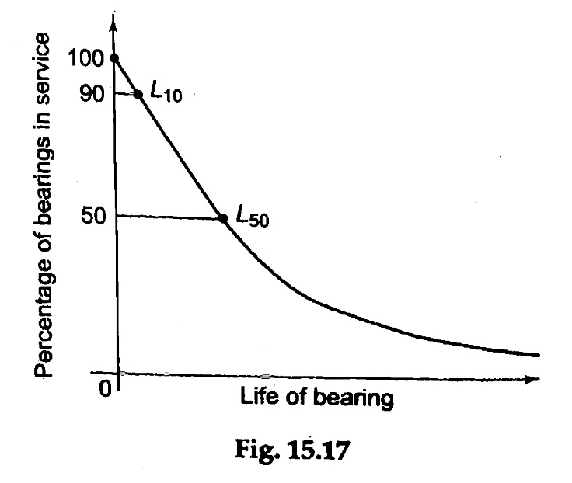
For Wiebull Distribution,
………………. (6)
where R is the reliability (in fraction), L is the
corresponding life and a and b are constants.
Rearranging the above equation, we have
…………….. (a)
If L₁₀ is the life corresponding to a reliability of 90% or R₉₀, then,
……………. (b)
Fig. 3: Wiebull Distribution

Slide 18
Dividing eq. (a) by eq. (b),
………………. (7)
where R₉₀ = 0.9
The values of a and b are, a = 6.84 and b= 1.17
These values are obtained from the condition,
L₅₀ = 5L₁₀ …...………….. (8)
where L₅₀ is the median life or life which 50% of the bearings will complete or exceed before fatigue failure.
Equation (7) is used for selecting the bearing when the reliability is other than 90%.

Slide 19
In a system, if there are a number of bearings, the individual reliability of each bearing should be fairly high. If there are N bearings in the system, each having the same reliability R then the reliability of the complete system is given by,
R_{s}= (R)^{N} …………………….. (9)
where R_{s} indicates the probability of one out of N bearings failing during its lifetime.

Slide 20
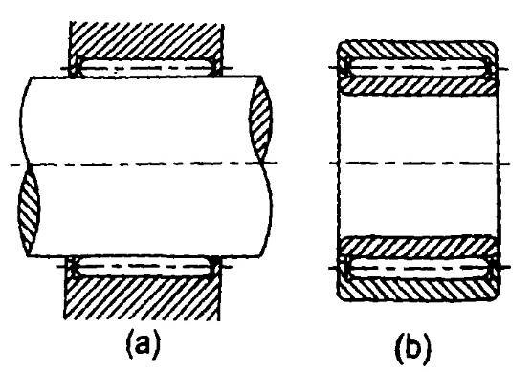
Needle Bearings
Needle bearings are characterised by cylindrical rollers of very small diameter and relatively long length.
They are also called `quill' bearings.
The length to diameter ratio of needles is more than four.
Needle bearings are used with or without inner and outer
races as shown in Fig. 4.
Very often, needle bearings are used without the races as shown in Fig. 4 (a).
In this case, the needles run directly on the surface of the shaft.
The shaft is hardened and ground with a surface hardness of 50 HRC.
This type of construction is suitable where limited radial space is available.
Fig. 4: Needle Bearings

Slide 21
Advantages of Needle bearings
(i) They have a small outer diameter. It is due to this reason that they are often used to replace sleeve bearings. This allows replacement with little or no changes in design.
(ii) They are compact and lightweight compared with other types of bearings.
(iii) They have large load carrying capacity compared to their size.
(iv) They have large load carrying capacity particularly at low peripheral speeds.
Needle bearings are ideally suited for applications involving oscillatory motion such as piston pin bearings, rocker arms and universal joints.
They are also suitable for continuous rotation where the load is variable or intermittent.

Slide 22
Although needle bearings are considered as a variety of cylindrical roller bearings, they have altogether different characteristics.
Short roller bearings can be manufactured with a high degree of accuracy.
The needles, which are considerably longer than their diameter, cannot be manufactured with the same degree of accuracy.
Short rollers are accurately guided in their cage and races. Needles are not guided to that extent. This results in high friction in needle bearings.
The coefficient of friction in cylindrical roller bearings is 0.0011. On the other hand, the coefficient of friction in needle bearings is 0.0045 or almost four times.

Slide 23
Bearing Failure-Causes and Remedies
There are two basic types of bearing failure breakage of parts like races or cage and the surface destruction.
The fracture in the outer race of the ball bearing occurs due to overload.
When the bearing is misaligned, the load acting on some balls or rollers sharply increases and may even crush them.
The failure of the cage is caused due to the centrifugal force acting on the balls.
The complete breakage of the parts of the ball bearing can be avoided by selecting the correct ball bearing, adjusting the alignment between the axes of the shaft and the housing and operating within permissible speeds.
In general, the failure of antifriction bearing occurs not due to breakage of parts but due to damage of working surfaces of their parts.

Slide 24
The principal types of surface wear are as follows:
Abrassive Wear
Corrosive Wear
Pitting
Scoring
Abrassive Wear
Abrasive wear occurs when the bearing is made to operate in an environment contaminated with dust, foreign particles, rust or spatter.
Remedies against this type of wear are provision of oil seals, increasing surface hardness and use of high viscosity oils.
The thick lubricating film developed by these oils allows fine particles to pass without scratching.

Slide 25
Corrosive Wear
The corrosion of the surfaces of bearing parts is caused by the entry of water or moisture in the bearing.
It is also caused due to corrosive elements present in the Extreme Pressure (EP) additives that are added in the lubricating oils.
These elements attack the surfaces of the bearing, resulting in fine wear uniformly distributed over the entire surface.
Remedies against this type of wear are, providing complete enclosure for the bearing free from external contamination, selecting proper additives and replacing the lubricating oil at regular intervals.

Slide 26
Pitting
Pitting is the main cause of the failure of antifriction bearings.
Pitting is a surface fatigue failure which occurs when the load on the bearing part exceeds the surface endurance strength of the material.
This type of failure is characterised by pits, which continue to grow resulting in complete destruction of the bearing surfaces.
Pitting depends upon the magnitude of Hertz' contact stress and the number of stress cycles.
The surface endurance strength can be improved by increasing the surface hardness.
Scoring
Excessive surface pressure, high surface speed and inadequate supply of lubricant result in breakdown of the lubricant film.

Slide 27
This results in excessive frictional heat and overheating at the contacting surfaces.
Scoring is a stick-slip phenomenon, in which alternate welding and shearing takes place rapidly at high spots.
Here, the rate of wear is faster. Scoring can be avoided by selecting the parameters, such as surface speed, surface pressure and the flow of lubricant in such a way that the resulting temperature at the contacting surfaces is within permissible limits.

Slide 28
Lubrication of Rolling contact bearings
The purpose of lubrication in antifriction bearings is to reduce the friction between balls and races.
The other objectives are dissipation of frictional heat, prevention of corrosion and protection of the bearing from dirt and other foreign particles.
There are two types of lubricants—oil and grease. Compared with grease, oil offers the following advantages:
It is more effective in carrying frictional heat.
It feeds more easily into contact areas of the bearing under load.
It is more effective in flushing out dirt, corrosion and foreign particles from the bearing.
The advantages offered by grease lubricated bearings are simple housing design, less maintenance cost, better sealing against rust and less possibility of leakage.

Slide 29
The guidelines for selecting the lubricant are as follows:
When the temperature is less than 100°C, grease is suitable, while lubricating oils are preferred for applications where the temperature exceeds 100°C.
When the product of bore (in mm) x speed (in rpm) is below 2,00,000, grease is suitable. For higher values, lubricating oils are recommended.
Grease is suitable for low and moderate loads, while lubricating oils are used for heavy duty applications.
If there is a central lubricating system, which is required for the lubrication of other parts, the same lubricating oil is used for bearings, e.g., gearboxes.
The choice of lubricating oil is necessary for high speed, heavy load applications, while in the remaining majority of applications, grease offers the simplest and cheapest mode of lubrication.

Slide 30
Mounting of bearing
The inner race of the bearing is fitted on the shaft by means of an interference fit.
It prevents the relative rotation and the corresponding wear between the inner race and the shaft.
Tolerances for shaft diameter, corresponding to this type of interference fit, are given in the manufacturer's catalogue.
Care should be taken to select the fit in such a way that it provides sufficient tightness to give a firm mounting and at the same time, it is not too tight a fit to cause deformation of the inner race and destroying clearance between the rolling elements and the races.
The outer race is also mounted in the housing with interference fit, but to a lesser degree of tightness than that of the inner race. Insufficient tightness of the outer race in the housing seat may cause 'creep’.
In bearing terminology, creep is slow rotation of the outer race relative to its seating.

Slide 31
It is caused when the shaft is subjected to external force that rotates and changes its direction.
When two bearings are mounted on the same shaft, the outer race of one of them should be permitted to shift axially to take care of axial deflection of the shaft caused either by thrust load or by the temperature variation.
It is necessary to position inner and outer races axially by positive means.
There are several methods such as providing shoulders for the shaft or the housing, lock nut, snap ring or cover plates as shown in Fig. 5.
The basic principle is to restrict the displacement of inner as well as outer race in axial direction by positive means.
Figure 5(a) shows the mounting suitable for a long and continuous shaft. It consists of an adapter sleeve, which is provided with a small taper. The bearing is press fitted on this adapter sleeve.

Slide 32
Because of the taper, the displacement of the inner race to the left side is restricted. A washer and lock nut is provided to restrict the displacement of the inner race to the right side.
Two methods of restricting the displacement of the inner race are illustrated in Figs. 5(b) and (c).
In both the cases, the shaft is provided with a shoulder to restrict the displacement of the inner race to the left side.
In Fig. 5(b), the displacement of the race to the right side is restricted by a plate, which is bolted to the shaft.
In Fig. 5(c), a snap-ring is used in place of the plate.
In Fig. 5(d), the housing is provided with a shoulder to restrict the displacement of the outer race to the left side.

Slide 33
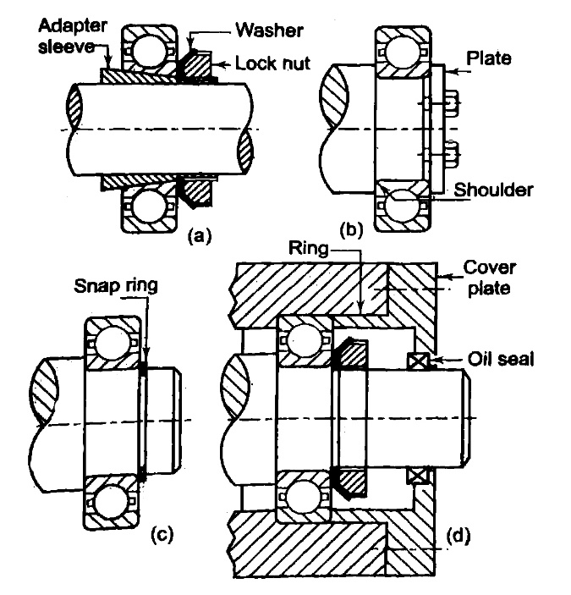
Fig. 5: Mountings of bearing

Slide 34
A circular ring of the cover plate restricts the displacement to the right side.
The cover plate is bolted to the housing.
Commercial oil seal unit is used to prevent the leakage of lubricating oil.
The shoulders for the shaft and housing bore have standards dimension, which can be obtained from the manufacturer's catalogue.
Shafts and spindles in machine tools and precision equipment should rotate without any play or clearance either in axial or radial direction.
This is achieved by preloading the ball bearings. The objective of preloading is to remove the internal clearance usually found in the bearing.
Preloading of cylindrical roller bearing is obtained by the following methods:
The roller bearing is mounted on a taper shaft or sleeve, which causes the inner race to expand and remove the radial clearance.
The outer race is fitted in the housing bore by an interference fit. It causes the outer race to contract and remove the radial clearance.

Slide 35
Ball bearings, such as angular contact bearing, are preloaded by axial force by tightening the lock nut during the assembly.
It is essential to use the correct method of mounting and to observe cleanliness if the bearing is to function with satisfaction and achieve the required life.
The precautions to be taken during the mounting operation are as follows:
Mounting should be carried out in a dust-free and dry environment. Machines which produce metal particles, chips or sawdust should not be located in the vicinity of the mounting operation.
Before assembly, the shaft and the housing bore should be inspected. The burrs on the shaft and the shoulders should be removed. The accuracy of the form and dimensions of the shaft and bearing seat in the housing should be inspected.
The bearing should not be taken out from its package until before it is assembled. The rust-inhibiting compound on the bearing should not be wiped except on the outer diameter and bore surface. These inner and outer surfaces are cleaned with white spirit and wiped with clean cloth.

Slide 36
Small bearings are mounted on the shaft with the help of a small piece of tube or ring. Blows are applied by means of a hammer on this tube or ring. Direct blows should never be applied to the bearing surface, otherwise the race or the cage may get damaged. The tube or the metallic ring is placed against the inner race and the blows are applied with an ordinary hammer all around the periphery of the ring.
Medium size bearings are mounted on the shaft by pressing the tube or the metallic ring by means of a hydraulic or mechanical press. Large size bearing is mounted by heating it to 80° to 90°C above the ambient temperature by induction heating and then shrinking it on the shaft. The bearing should never be heated by direct flame.
The interference fit between the outer race and the housing is obtained by similar methods, viz., by applying hammer blows on a metallic ring or tube which is in contact with the outer race or by using hydraulic or mechanical press or by heating the housing.

